Slide 1
An Overview of Sunshine Law

Slide 2
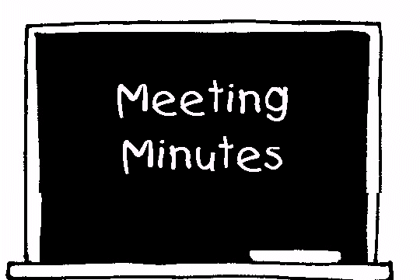
Basic Requirements of Sunshine Law
Reasonable public notice of the meeting must be given.
The meeting must be open to the public, in a location accessible to the public.
Minutes of the meeting must be taken and must be made available for public
inspection following the meeting.

Slide 3
Notice Requirements
The notice should contain the time and place of the meeting
On Timber Trace’s Web Page and text alerts will also be sent each month to all voting members
The notice should be prominently displayed

Slide 4
Meeting Minutes
Minutes of meetings are required and are open for public inspection.
The written minutes of SAC meetings need not be verbatim transcripts.
Represent brief summary or series of brief notes or memoranda reflecting the events of the meeting.
Notes:
4
acknowledge assistance from Pat Gleason, Dept Gen Counsel to Gov Crist (formerly w/ AG’s office)
Reference committees of one (1)
Will discuss access a little later in the presentation

Slide 5
Open Meeting Requirement
Informal Conversations of SAC Members
Can Be Subject to the Sunshine Law
Even informal discussions of members of the same
committee can be subject to the Sunshine Law.
Sunshine Law applies to "any gathering, whether formal or informal, of two or more members of the same board or commission to discuss some matter on which foreseeable action will be taken by the public board or commission."
If two members of the same committee informally discuss selecting a new member, that discussion is subject to the requirements of the Sunshine Law and must be conducted at an open forum.
Notes:
5
Ok to still travel together, eat together, but be aware of perception
Ex of bd mbr who was recently recused on a disciplinary case who asked me if he could ask for a recess of the hearing if he felt the proceeding wasn’t going as he felt it should – so that he could then talk w/ the bd mbrs handling the hearing to give the his input

Slide 6
Voting at Meetings
The SAC may not take a secret vote at its meeting on an issue.
Florida statute also applies to School Advisory Council's requires that "a vote shall be recorded or counted for each member present”
Secret votes are not allowed by SAC members at their SAC meetings.

Slide 7
Written Correspondence Can Violate the Sunshine Law
Written communications between SAC members is prohibited under Sunshine concerning matters which may foreseeably come before the SAC

Slide 8
Timber Trace Elementary Vision
Timber Trace Elementary School staff, parents and community will work together to offer and encourage every student to achieve the academic, technological, social, physical, and emotional skills necessary to reach his or her greatest potential.

Slide 9
Timber Trace Elementary Mission
The mission of Timber Trace
Elementary School is to provide an
education which prepares every
child for successful, life-long
learning and for responsible
citizenship. Parents, community,
staff and students will share the
responsibility of education in a
safe climate that facilitates student
achievement through active
learning, self-esteem and mutual
respect.

